Slide 1

Handwritten Digit Recognition using “MNIST”
Presented By :
Shreyas Sule Harish Kumar. Deepansh Parab
Deepansh Parab

Slide 2
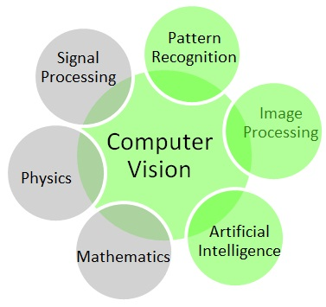
Introduction
Our brains make vision seem easy. It doesn't take any effort for humans to tell apart a lion and a jaguar, read a sign, or recognize a human's face.
But these are actually hard problems to solve with a computer: they only seem easy because our brains are incredibly good at understanding images.
Computer vision deals with how computers can be made for gaining high-level understanding from digital images or videos.

Slide 3
The Next Big Thing
From programs that help the visually impaired and safety features in cars the benefits of image recognition, or computer vision, are only just beginning to make their way into the world
Image recognition is a vital component in security systems such as face recognition.
Image recognition is also important in image search engines such as Google or Bing image search whereby you use rich image content to query for similar stuff.
Computer Vision is useful in many areas, including safety, health, security, comfort, fun and access. Specific examples include:
object recognition
urveillance and security
gesture recognition
games, virtual reality, augmented reality

Slide 4

Hello World
When one learns how to program, there's a tradition that the first thing you do is print "Hello World." Just like programming has Hello World, machine learning has MNIST
MNIST ("Modified National Institute of Standards and Technology") is the de facto “hello world” dataset of computer vision.
This classic dataset of handwritten images has served as the basis for benchmarking classification algorithms.
As new machine learning techniques emerge, MNIST remains a reliable resource for researchers and learners alike
MNIST is a simple computer vision dataset. It consists of images of handwritten digits like these:

Slide 5
Understanding MNIST
The data files train.csv and test.csv contain gray-scale images of hand-drawn digits, from zero through nine.
The MNIST dataset’s train.csv contains 55,000 data points of training data and test.csv contains 10,000 points of test data.
Each image of hand-drawn digits is 28 pixels in height and 28 pixels in width, for a total of 784 pixels in total.
Each pixel has a single pixel-value associated with it, indicating the lightness or darkness of that pixel, with higher numbers meaning darker. This pixel-value is an integer between 0 and 255, inclusive.
Source for MNIST dataset : http://yann.lecun.com/exdb/mnist/
The evaluation metric is the categorization accuracy, or the proportion of test images that are correctly classified. For example, a categorization accuracy of 0.97 indicates that you have correctly classified all but 3% of the images.

Slide 6
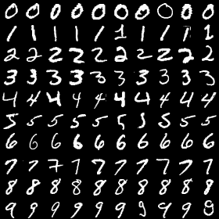
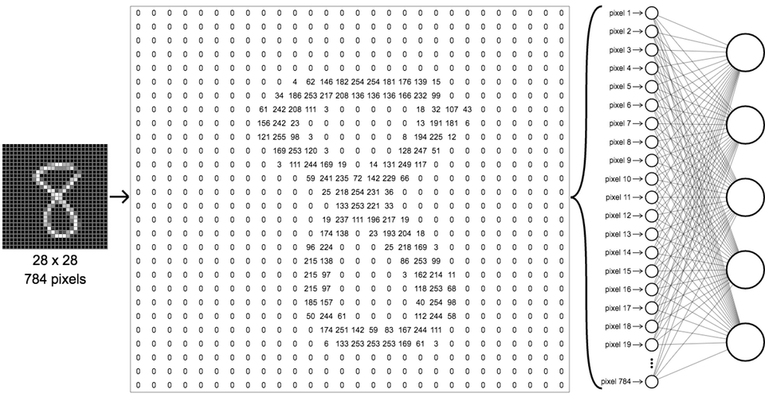
MNIST Dataset Example
Image of hand-drawn digits from zero through nine.
One image of 28x28 pixels.
The pixels with high intensity values are seen
forming the number 8

Slide 7
Classification Models :
Being in this computer and data sciences industry, one thing that is going to be constant is the change.
We generate humongous amount of data knowingly or unknowingly as we keep using different applications.
Owing to this fact, to utilize or analyze this valuable information, we have a wide range of different algorithms, that come to the rescue.
We are doing to discuss some of the crucial algorithms in the field of data science and machine learning as follows :
KNN(K-Nearest Neighbours)
SVM
Random Forest
ANN

Slide 8
1.KNN
A k-nearest neighbor classifier is incredibly easy to describe: if you have a labeled data set x_{i}, and you want to classify some new item y, find the k elements in your data set that are closest to y, and then somehow average their labels to get the label of y.
In order to implement this, all you really need to do is answer two questions:
What is distance? Namely, if I have some x∈{x_{i}}, how do I determine the distance from x to y?
If I know that x1,x2,…,x_{k} are the k nearest neighbors of y, how do I "average their labels“?
Finding Distance : Euclidean Distance
The way it will be calculated for images is by summing the squared Euclidean distance between the corresponding pixels of two images.

Slide 9
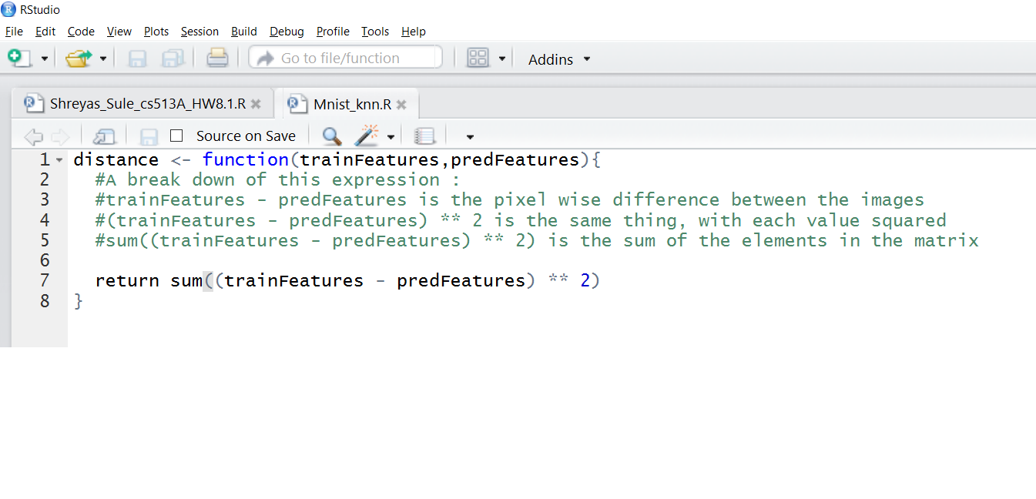
Code Snippet to calculate the Euclidean distance between 2 images

Slide 10
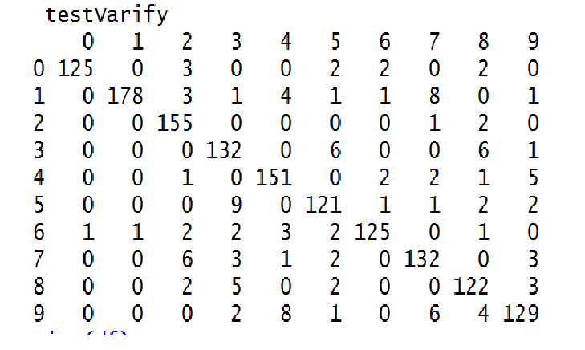
For demonstration purpose we ran the code on first 1500 test images for K equal to 10 and achieved the classification accuracy of 91.33% as you can see from the figure below.
The complete accuracy can be checked by using all the test images for classification process but it’ll take very long (maybe even a day).

Slide 11
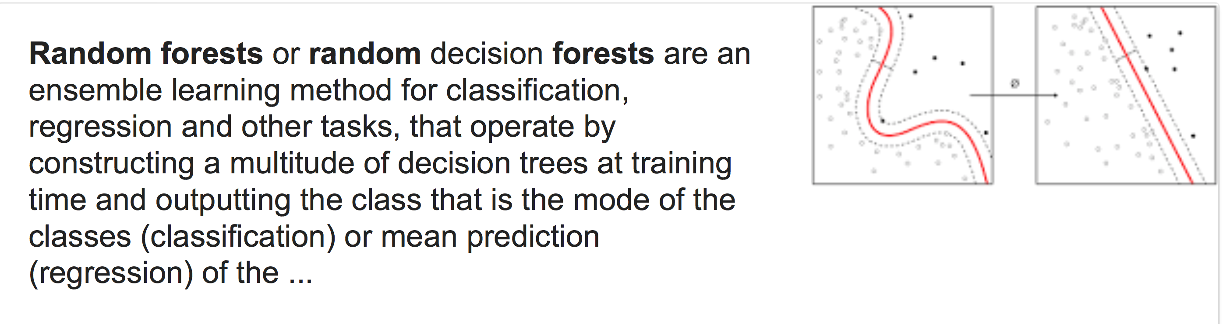
Random Forest

Slide 12
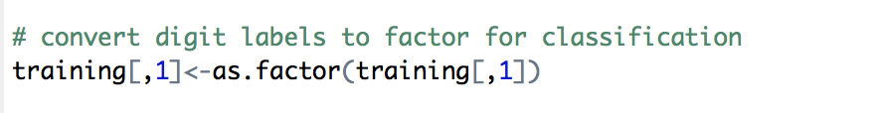
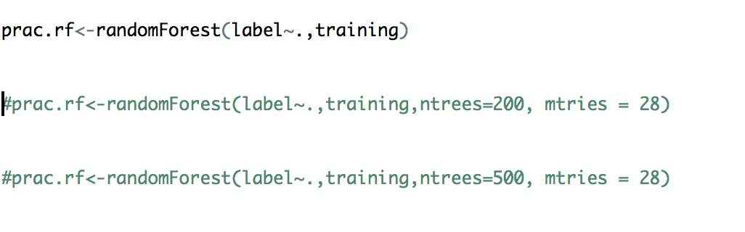
Some Important Parameters include:
Ntrees
Mtries

Slide 13
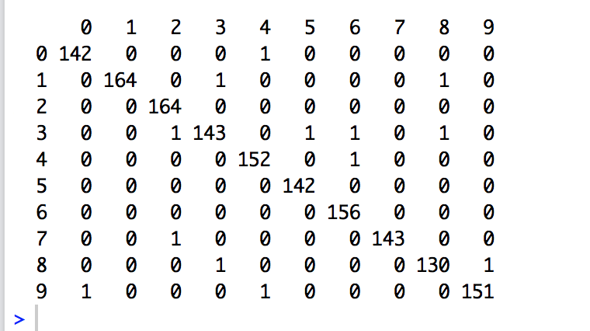
For demonstration purpose we ran the code on first 1500 test images for default setting achieved the classification accuracy of 97.2% as you can see from the figure below.
By tuning the parameters we get an increased accuracy of 97.99%

Slide 14
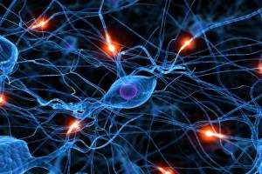
4.Artificial Neural Networks
Computer scientists have long been inspired by the human brain.
The artificial neural network (ANN) is a computational system modeled after the connectivity of human brain.
A neural network does not process data in a linear fashion.
Instead, information is processed collectively, in parallel throughout a network of nodes (the nodes, in this case, being neurons).

Slide 15
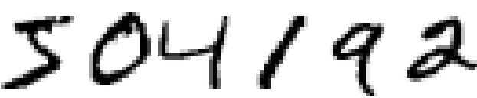
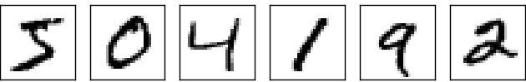
MNIST With Neural Networks
With an aim to achieve more accuracy and performance efficiency, we can approach the problem of recognizing handwritten digits into subproblems.
breaking an image containing many digits into a sequence of separate images.
Classifying the digits.
For example, we'd like to break the image
into six separate images :

Slide 16
Once the image has been segmented, the program then needs to classify each individual digit. So, for instance, we'd like our program to recognize that the first digit above is a 5:
There are many approaches to solving the segmentation problem.
One approach is to trial many different ways of segmenting the image, using the individual digit classifier to score each trial segmentation.
A trial segmentation gets a high score if the individual digit classifier is confident of its classification in all segments, and a low score if the classifier is having a lot of trouble in one or more segments.

Slide 17
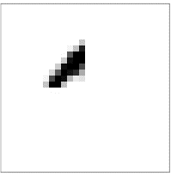
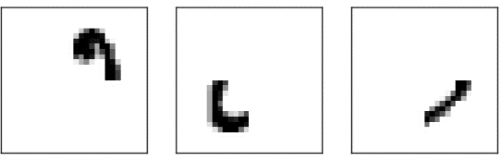
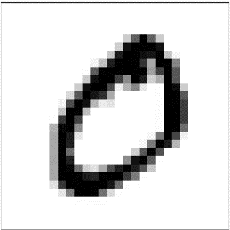
What are those hidden neurons doing?
for the sake of argument that the first neuron in the hidden layer detects whether or not an image like the following is present:
It can do this by heavily weighting input pixels which overlap with the image, and only lightly weighting the other inputs.
Similarly, from the second, third and fourth neurons in hidden layer detect whether or not following images are present :
Combining the above for,

Slide 18
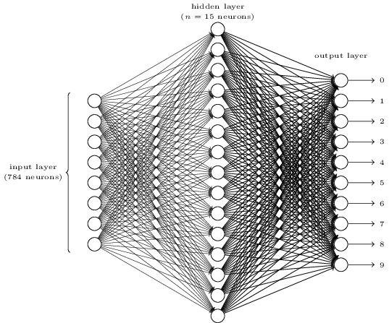
Developing the neural network
To recognize individual digits we will use a three-layer neural network :

Slide 19
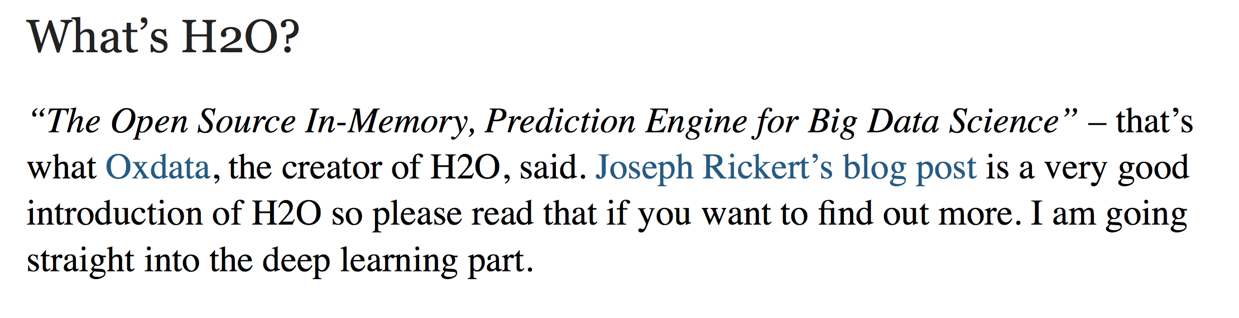
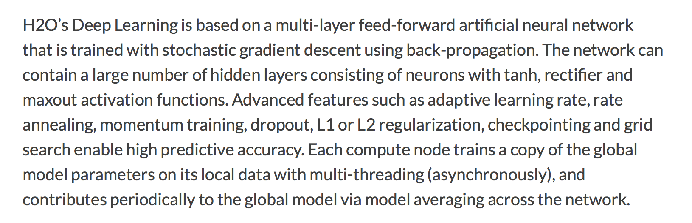

Slide 20
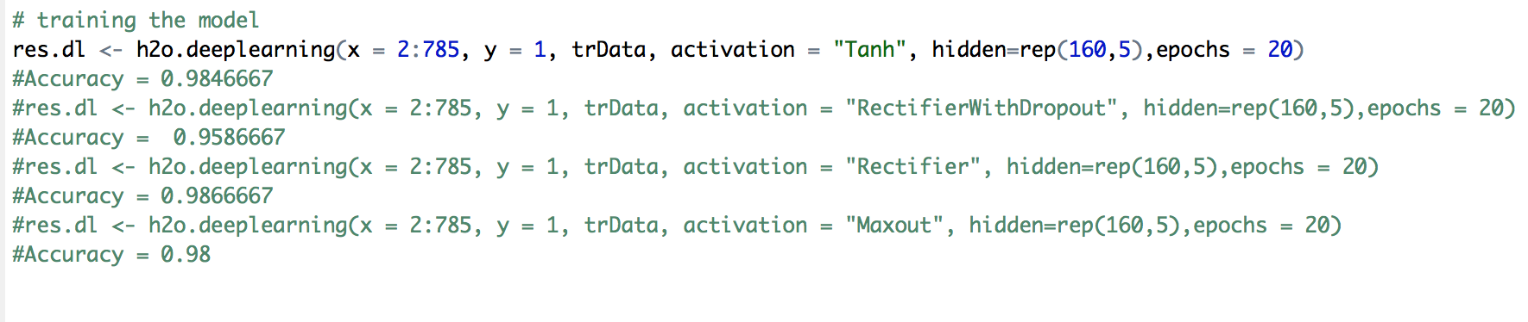
Some Important Parameters include:
X = predictors
Y= response
Activation model
Hidden
Echos

Slide 21
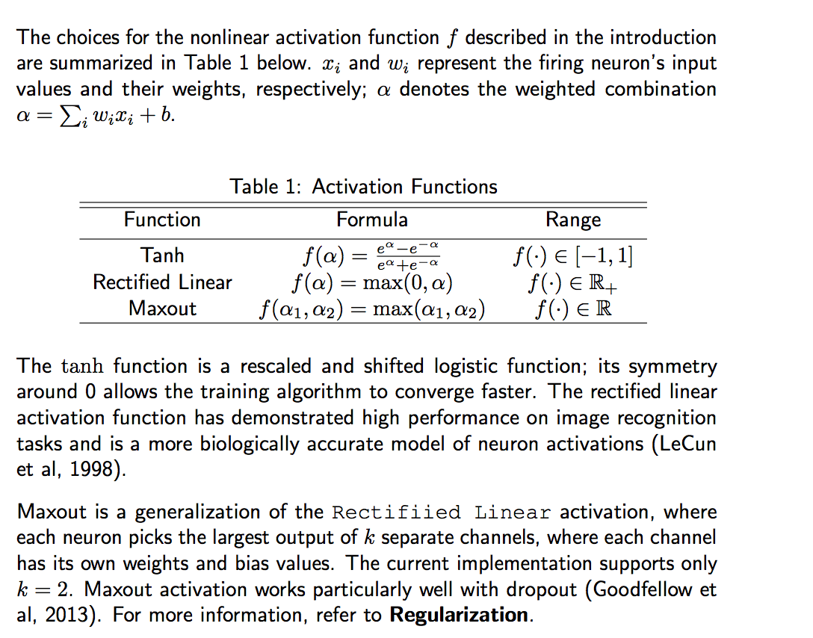

Slide 22
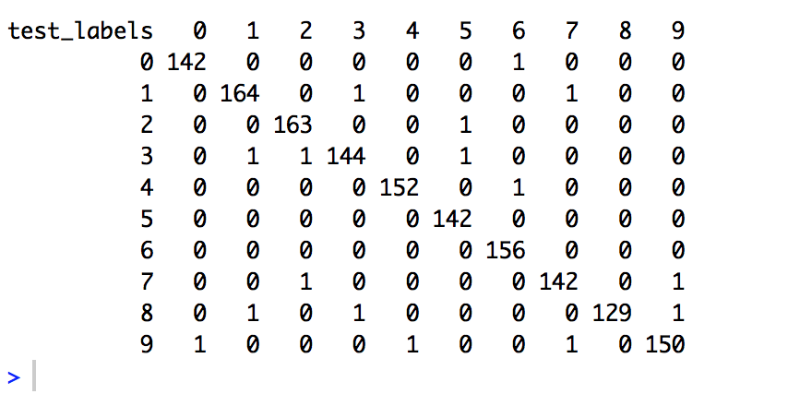
Results
For demonstration purpose we ran the code on first 1500 test images for default setting achieved the classification accuracy of 98.46% as you can see from the figure below.
By tuning the parameters we get an increased accuracy of 98.86%

Slide 23
Thank you
Any question?

